Slide 1
RISK MANAGEMENT

Slide 2
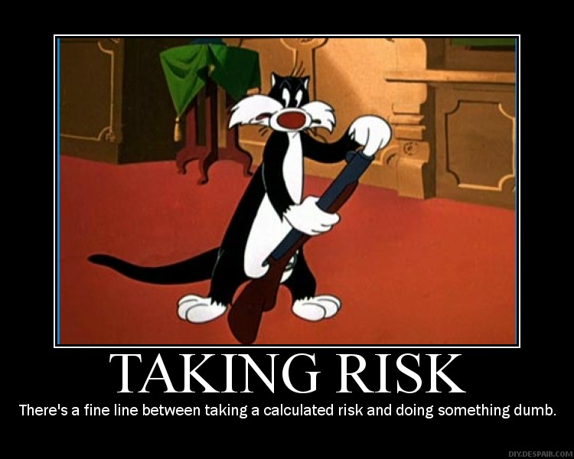
What is a risk?
A risk is an event that happens unexpectedly and can affect your project positively or negatively. Risks can impact any element relating to the project, including resources, equipment, staff, and production processes.

Slide 3
Positive and negative risks
Positive risks
Negative risks
Positive risks, also known as opportunities or upside risks, present the potential for beneficial outcomes and favourable developments that can propel projects forward and enhance organizational performance.
Negative risks, often referred to as threats or downside risks, pose the risk of adverse consequences and detrimental impacts that can impede delay and ruin success.

Slide 4
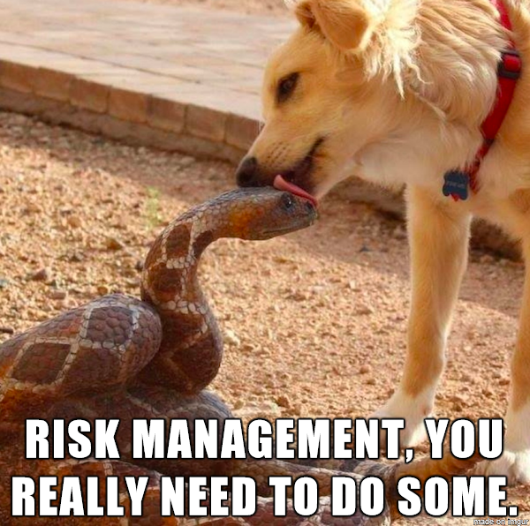
WHAT IS RISK MANAGEMENT?
Risk management is the process of identifying, assessing and controlling financial, legal, strategic and security risks to an organization’s capital and earnings

Slide 5
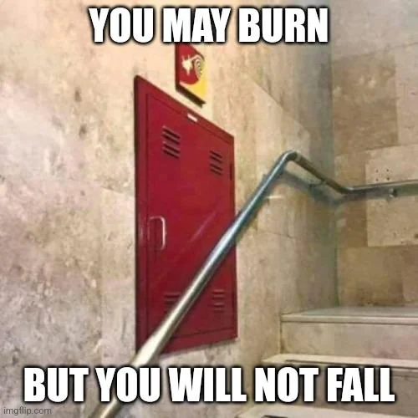

Slide 6


Slide 7
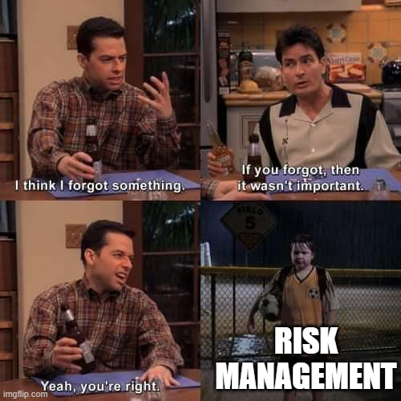
Why risk management is important?
If an unforeseen event catches your organization unaware, the impact could be minor, such as a small impact on your overhead costs. In a worst-case scenario, though, it could be catastrophic and have serious ramifications, such as a significant financial burden or even the closure of your business.

Slide 8
Q: What is the main goal of risk management?

Slide 9

“We don't manage risks so we can have no risk. We manage risks so we know which risks are worth taking, which ones will get us to our goal, which ones have enough of a payout to even take them”

Slide 10
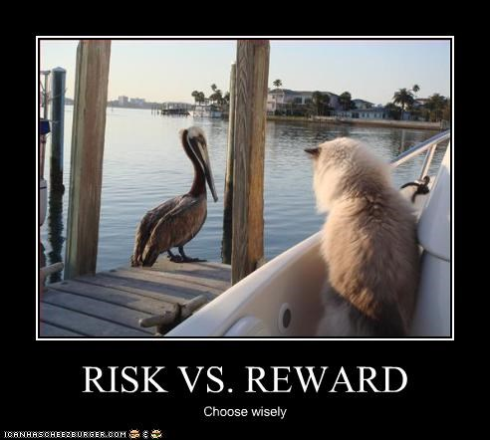

Slide 11
Q: Can you give me some example of Risks in IT project

Slide 12
5 PROJECT RISK EXAMPLES AND HOW TO MANAGE THEM

Slide 13

SCOPE CREEP
Scope risk, or “scope creep”, refers to the unexpected and uncontrolled expansion of a project’s objectives beyond its original intentions. This typically happens when project goals aren’t precisely outlined from the start or when requirements change partway through the project.

Slide 14
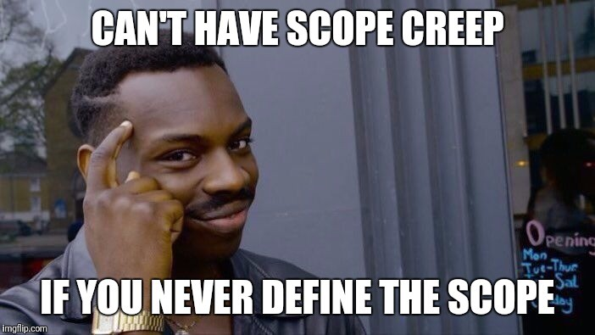
How to mitigate scope creep?
Before kicking off a project, it’s essential to solidify and agree upon the objectives, ensuring they are both clear and comprehensive. This foundational step minimizes any potential ambiguities and helps prevent unplanned alterations in the project’s scope.

Slide 15

Performance risks
Performance risk refers to a project’s potential not meeting its predefined success criteria or expectations. It simply means the project does not deliver the anticipated benefits or results despite meeting budgetary and time constraints.

Slide 16

How to mitigate performance risks
Spotting potential performance hazards from the start of a project is vital. This might mean assessing the current market landscape, going deep into users’ needs, and staying ahead of technological shifts.

Slide 17

External hazard risks
External hazard risks refers to unpredictable events stemming from external factors beyond project management’s control. These risks can be natural, such as climatic events, or man-made, like vandalism, terrorism, or societal disruptions.

Slide 18

How to mitigate external hazards risks
While external hazards are unpredictable, proactive steps can lessen their impact. Use historical and political data to regularly assess risks based on the project’s locale and nature.

Slide 19
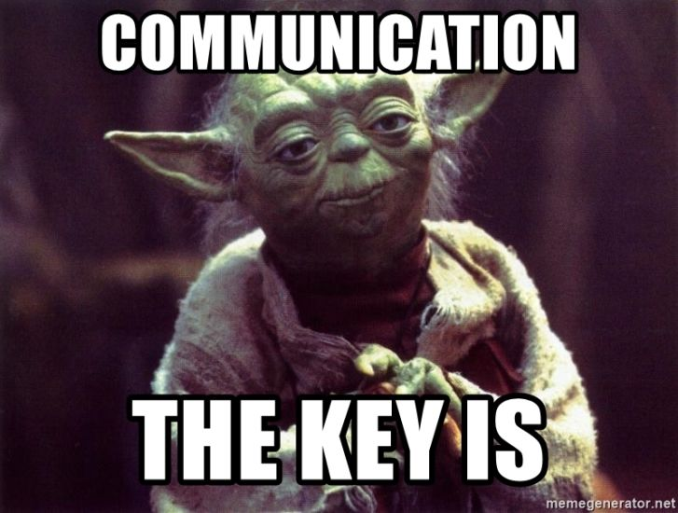
Communication risks
Lack of clarity in a project is a significant risk that arises from miscommunication, ambiguous project scopes, and unclear timelines. This uncertainty can lead to isolated tasks, exceeding budgetary constraints, missing deadlines, shifting project requirements, altering project directions, or ultimately resulting in unsatisfactory outcomes.

Slide 20
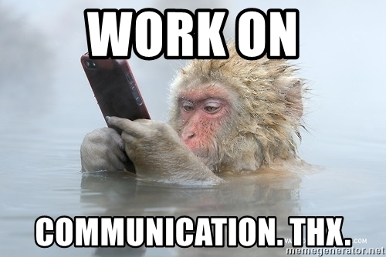
How to mitigate communication risks
Begin with well-defined scopes, objectives, and deadlines to minimize vagueness and align everyone’s expectations. Utilize a central tool or platform to keep everyone on the same page, thus avoiding siloed work.

Slide 21

Cost risks
Cost risk refers to the potential for a project to exceed its allocated budget. This can occur for various reasons, such as poor initial budgeting, scope changes mid-project, unforeseen complications, or inaccuracies in cost estimation.

Slide 22
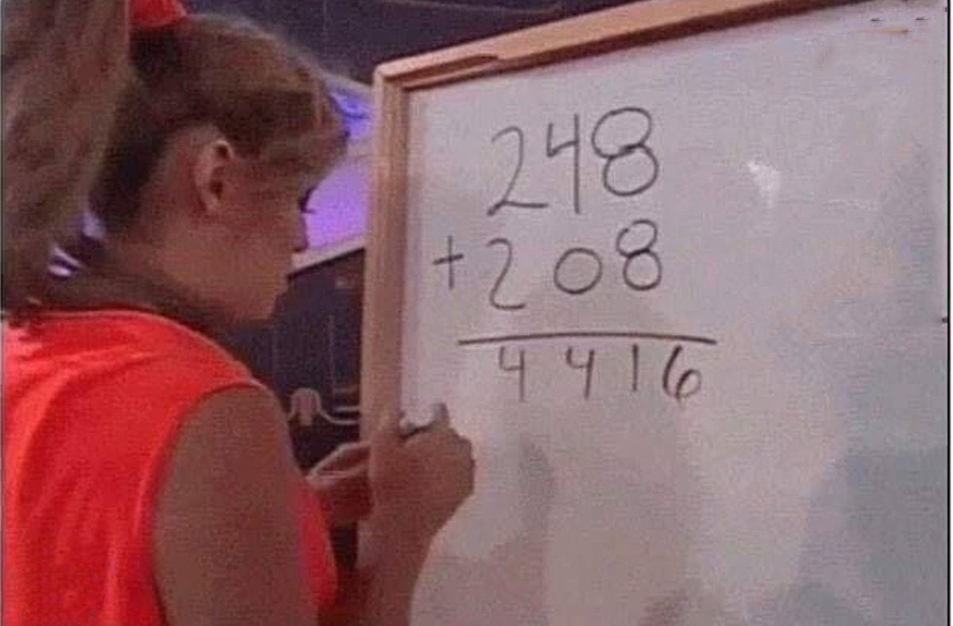
How to mitigate cost risks
Regularly comparing the budget to actual costs is critical, allowing early identification of discrepancies and prompt corrective measures. Project plan templates can align stakeholders on deliverables, scope, and timelines, ensuring collective financial goal alignment.

Slide 23
Types of Risk Management

Slide 24

Risk Acceptance
Acceptance is when an organization decides to accept the risks associated with a particular situation. With this kind of risk management, the company has recognized that it is not worth the cost and effort to mitigate the events that may occur due to the risk.

Slide 25

Risk Transference
Transferring risk is when an organization shifts the risks to another party, such as through insurance. For example, When a person or an organization gets insurance, the financial risk connected with an unfortunate event is transferred to the insurance company instead.

Slide 26

Risk Avoidance
Avoidance of risk is when an organization takes steps to prevent or avoid a particular risk from happening such as an injury, disease, or death. The company mitigates such risks by not involving in risky activities or situations.

Slide 27

Risk reduction and loss prevention
Loss prevention and reduction are when an organization takes steps or methods to reduce the impact of a particular risk that occurs. It combines risk acceptance as it acknowledges the risk involved while also focusing on how to reduce and contain the loss from spreading.

Slide 28

Risk Sharing
Risk sharing is when an organization distributes the risk to the whole team. This method removes the burden of problematic events to one department and shares it with others so that those who can help and provide support for that problem can help and control those risks.

Slide 29
RISK ASSESSMENT TOOLS

Slide 30
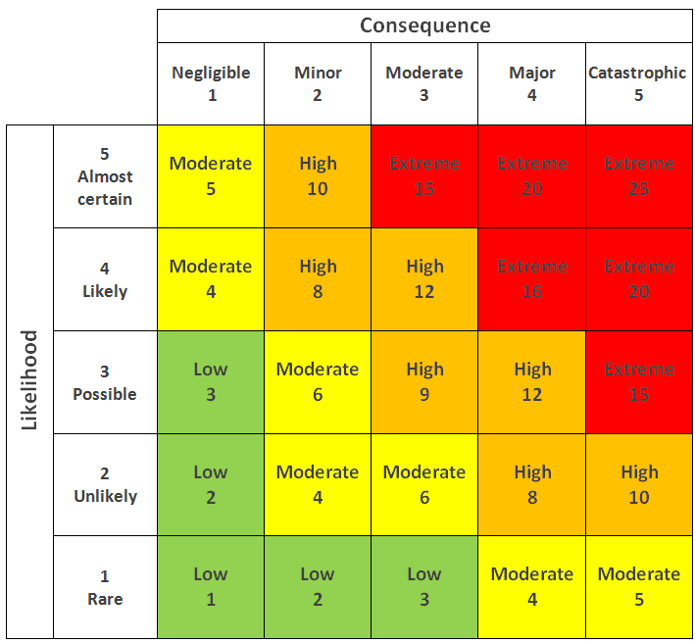
Risk Matrix
Risk is defined as probability multiplied by potential impact. A risk matrix breaks these out into separate scales and assigns numeric values to each level of probability and impact. This allows you to chart the values on a matrix and calculate the risk for each combination of values.

Slide 31
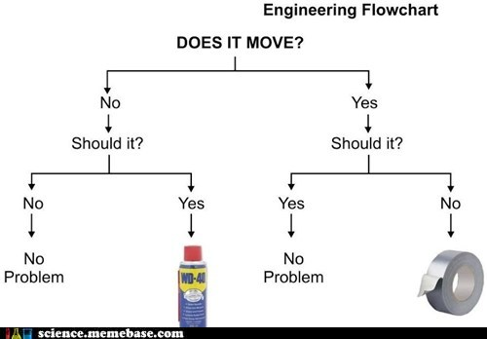
Decision Tree
A decision tree is a less frequently used risk assessment tool, but it can still come in handy. It’s particularly useful for understanding how to apply policies or choosing between different modes of action.
How a Decision Tree Works: A decision tree presents a series of questions or choices that branch out into a variety of outcomes.

Slide 32
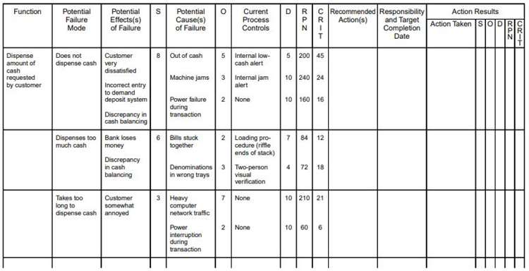
Failure Modes and Effects Analysis
How FMEA Works: an FMEA chart places the process step or design in question on individual rows, with vertical columns allowing you to map out:
Each potential failure and its cause
The effect on higher levels in the process, assembly or system
Existing controls and detection methods
Any required actions and associated details

Slide 33


Slide 34


Slide 35


